Slide 1
Counting
Part 3 – Permutation and Combination

Slide 2
PERMUTATION
Selection and Arrangement

Slide 3
Permutation
Permutation: In how many ways can we select r elements from a set of n elements, such that the order of the selected elements matter.
Example: How do we choose 5 students out of 10 and arrange them in one line?

Slide 4
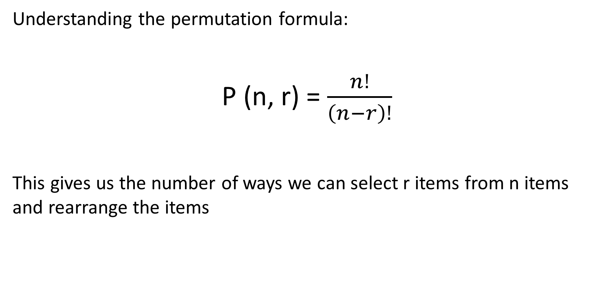
Permutation

Slide 5
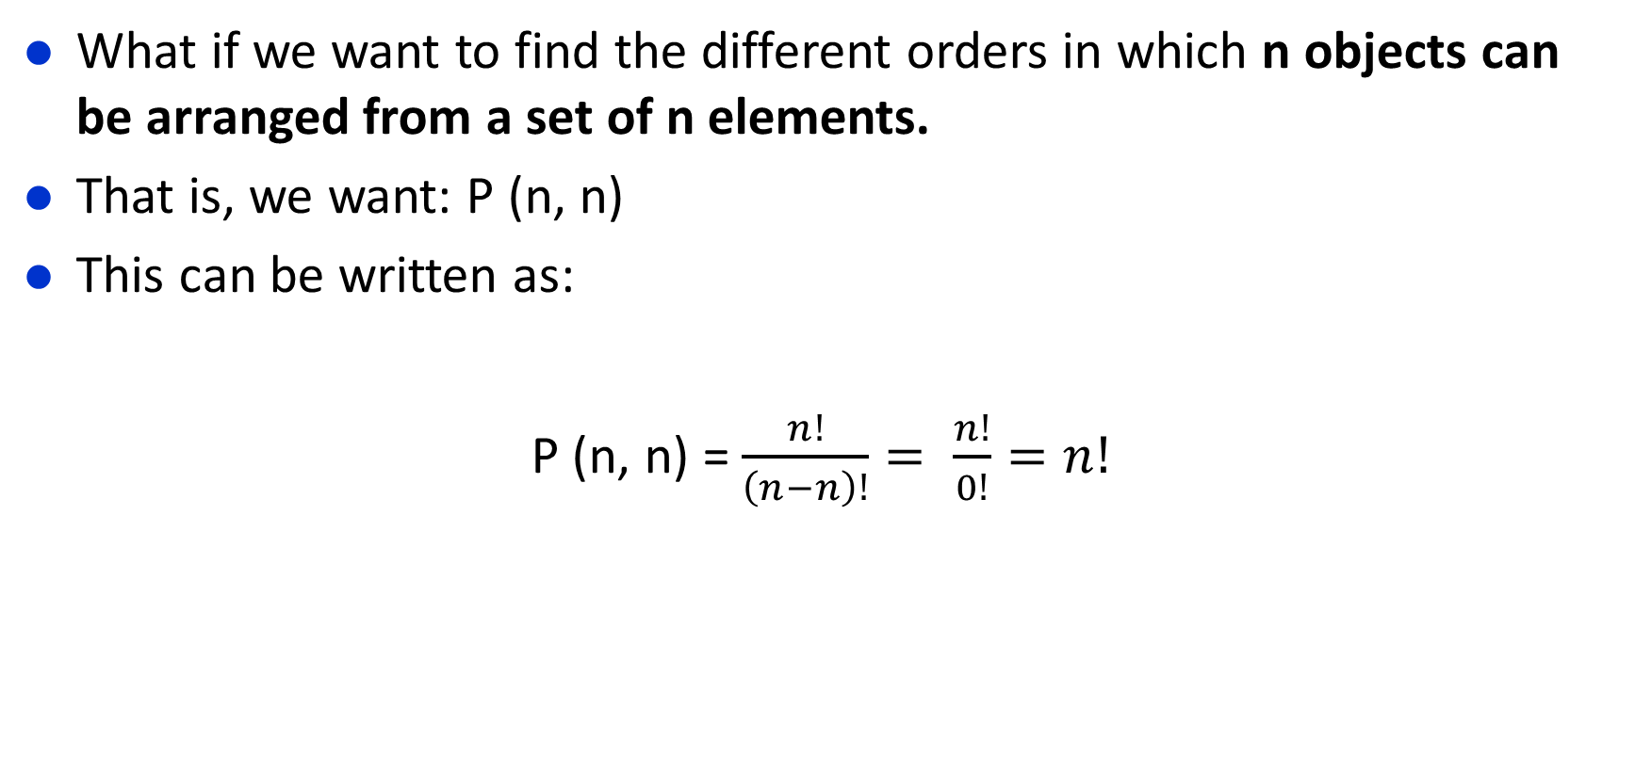
Permutation

Slide 6
COMBINATION
Selection

Slide 7
Combination
Example: We want to select 2 students for the same position of a committee from 4 students. In how many ways it can be done?
- C(4, 2)
Consider the 4 students to be a set of 4 elements, where each element is a student:
{a, b, c, d}
How many subsets containing 2 students can we have?
{a, b} {a, c} {a, d} {b, c} {b, d} {c, d}
C(4,2) = 6

Slide 8
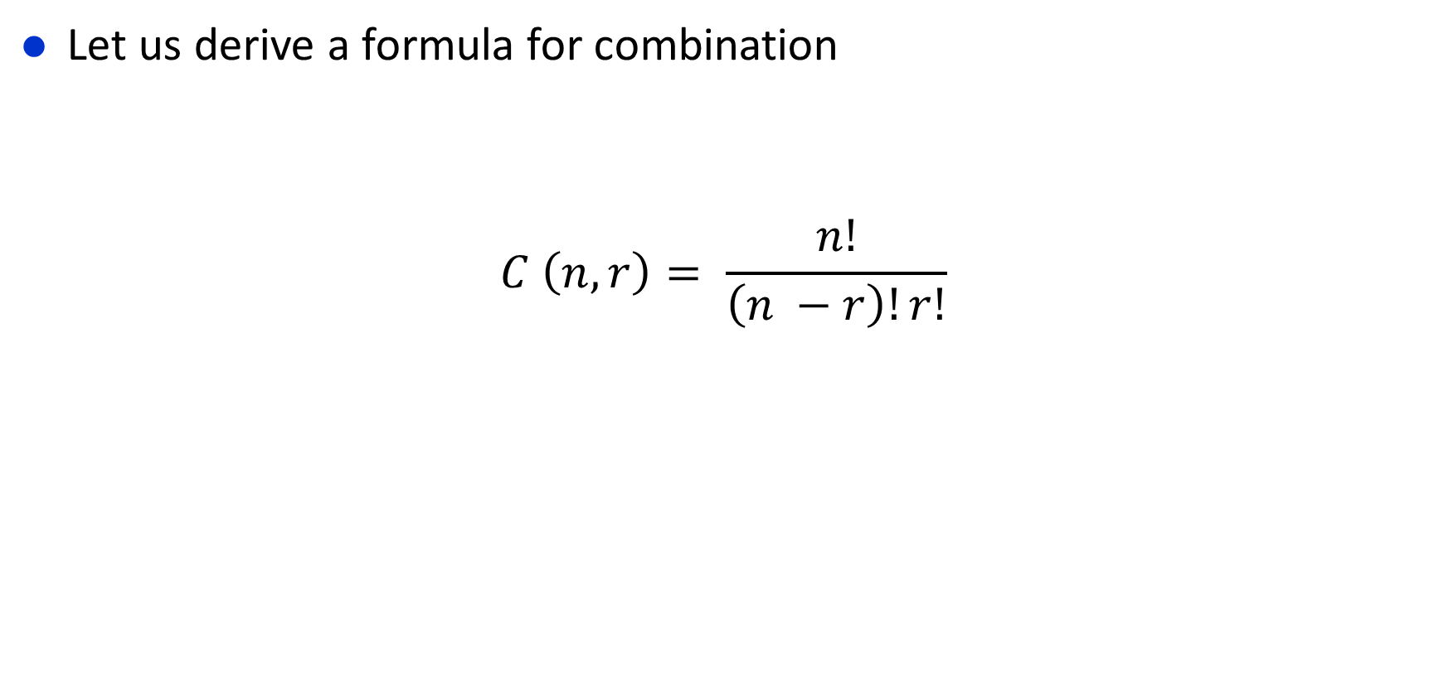
Combination

Slide 9
PRACTICE PROBLEMS

Slide 10
Practice Problems
8. In how many different orders can five runners finish a race if no ties are allowed?
9. How many possibilities are there for the win, place, and show (first, second, and third) positions in a horse race with 12 horses if all orders of finish are possible?
10. There are six different candidates for governor of a state. In how many different orders can the names of the candidates be printed on a ballot?

Slide 11
Practice Problems
11. How many bit strings of length 10 contain
a) exactly four 1s?
b) at most four 1s?
c) at least four 1s?
d) an equal number of 0s and 1s?
13.A group contains n men and n women. How many ways are there to arrange these people in a row if the men and women alternate?
15. In how many ways can a set of five letters be selected from the English alphabet?
17. How many subsets with more than two elements does a set with 100 elements have?
19. A coin is flipped 10 times where each flip comes up either heads or tails. How many possible outcomes a) are there in total? b) contain exactly two heads? c) contain at most three tails? d) contain the same number of heads and tails?

Slide 12
Practice Problems
21. How many permutations of the letters ABCDEFG contain
a) the string BCD?
b) the string CFGA?
c) the strings BA and GF?
d) the strings ABC and DE?
e) the strings ABC and CDE?
f ) the strings CBA and BED?
23. How many ways are there for eight men and five women to stand in a line so that no two women stand next to each other? [Hint: First position the men and then consider possible positions for the women.]

Slide 13
Practice Problems
25. How many ways are there for four men and five women to stand in a line so that a) all men stand together? b) all women stand together?
33. The English alphabet contains 21 consonants and five vowels. How many strings of six lowercase letters of the English alphabet contain
a) exactly one vowel?
b) exactly two vowels?
c) at least one vowel?
d) at least two vowels?

Slide 14
Thank You

